Slide 1


YouTube | DailyMotion
A comprehensive technical evaluation on usability on the most popular online video platforms.
Group 2 | 6 – CSE – 10

Slide 2
Components To Evaluate
According to the guidelines given by the interface designers that have been recorded in order to serve as a criteria for the future designers we have captured the following components to evaluate on.
Navigating the interface.
Organizing the display.
Getting user’s attention.
Facilitating data entry.

Slide 3
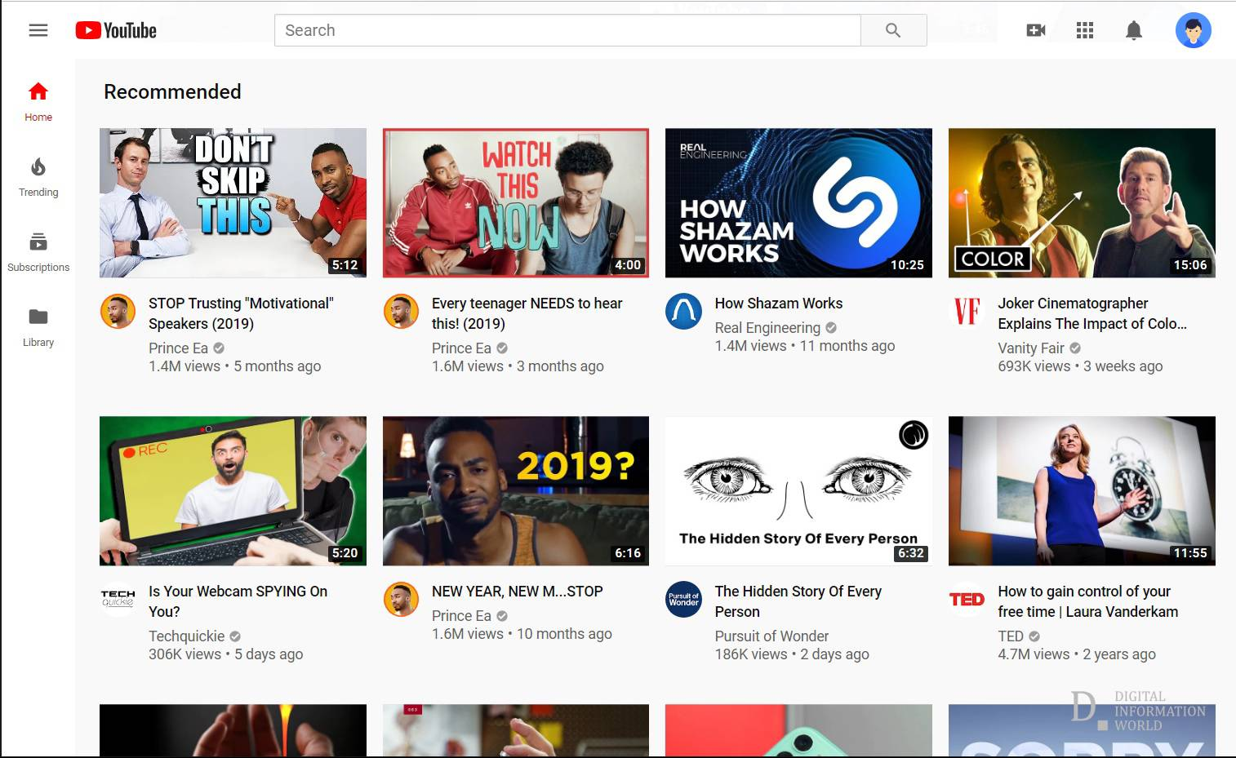
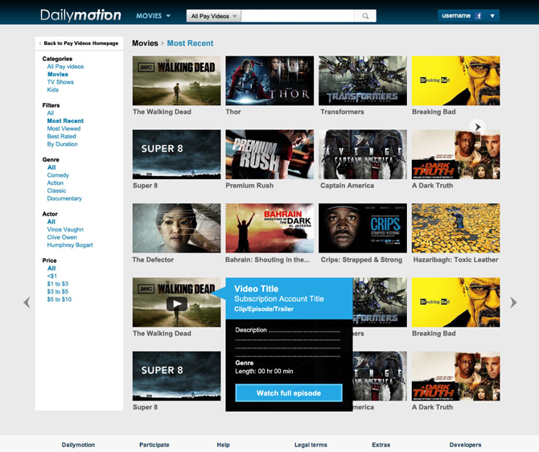
Navigating the interface.
A. The home page of YouTube.
Observation : The minimalist yet appealing design.
B. The home page of Daily motion
Observation : A design that is equally on par but is a sub-standard.

Slide 4

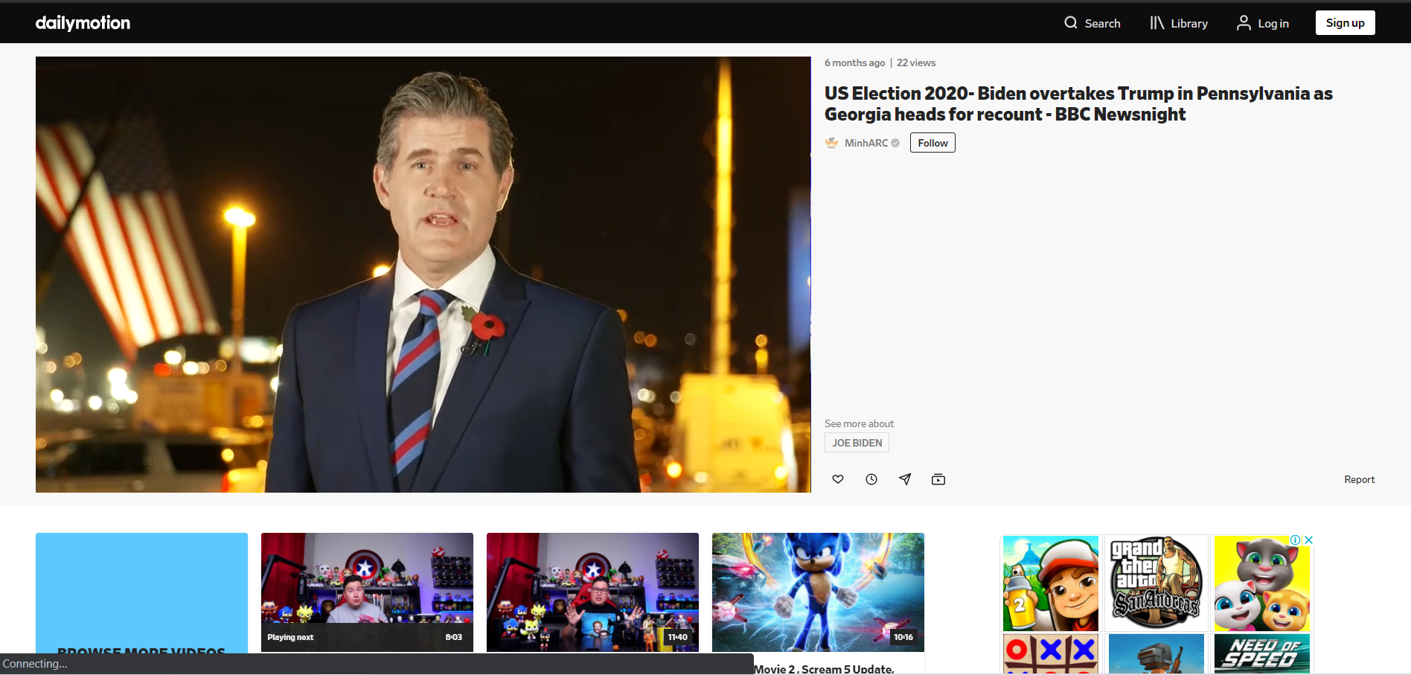
Organizing the display.
The display overlay structure of YouTube.
Observation : Positioning of the various components of the web-page.
B. The display structure of Daily motion.
Observation : Restricted ease of access and lower rate of response.

Slide 5
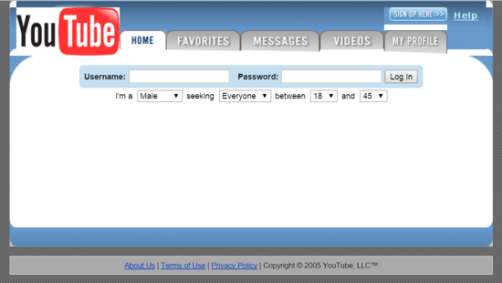
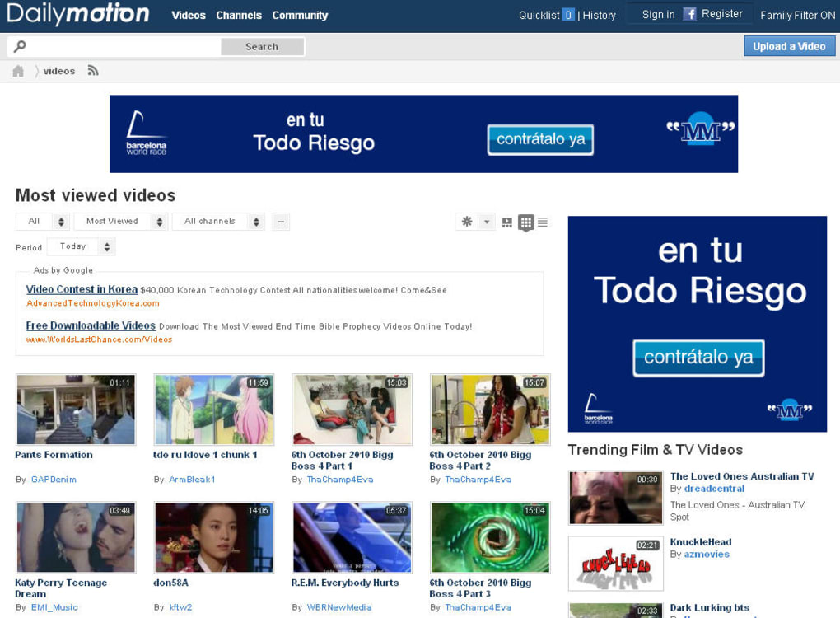
The First Web-Page Design
A. The first YouTube web-page that was designed and continued to evolve till date.
B. The first daily motion web-page that had very few updates since then.

Slide 6
Getting user’s attention.
YouTube
Daily Motion
Trending video’s section that is constantly being updated real-time.
A very strong recommendation algorithm that is very accurate in suggestions.
Creator friendly with the introduction of analytics dashboard that facilitates real time statistics.
Has a list of most famous viewed that is not real-time.
A comparatively decent algorithm that is not as accurate.
Creators need to be familiar with steps taken as the interface is not supportive to creators.

Slide 7

Facilitating data entry.
The crucial aspect of data entry is applying a minimal memory on users. There should not be any hinderance in trying to remember any kind of strings.
There should also be flexible entry keeping in mind the various kind of users who are going to utilize the data entry.
This aspect is common in both the websites we have compared. It shows how basic of a necessity is this guideline.

Slide 8
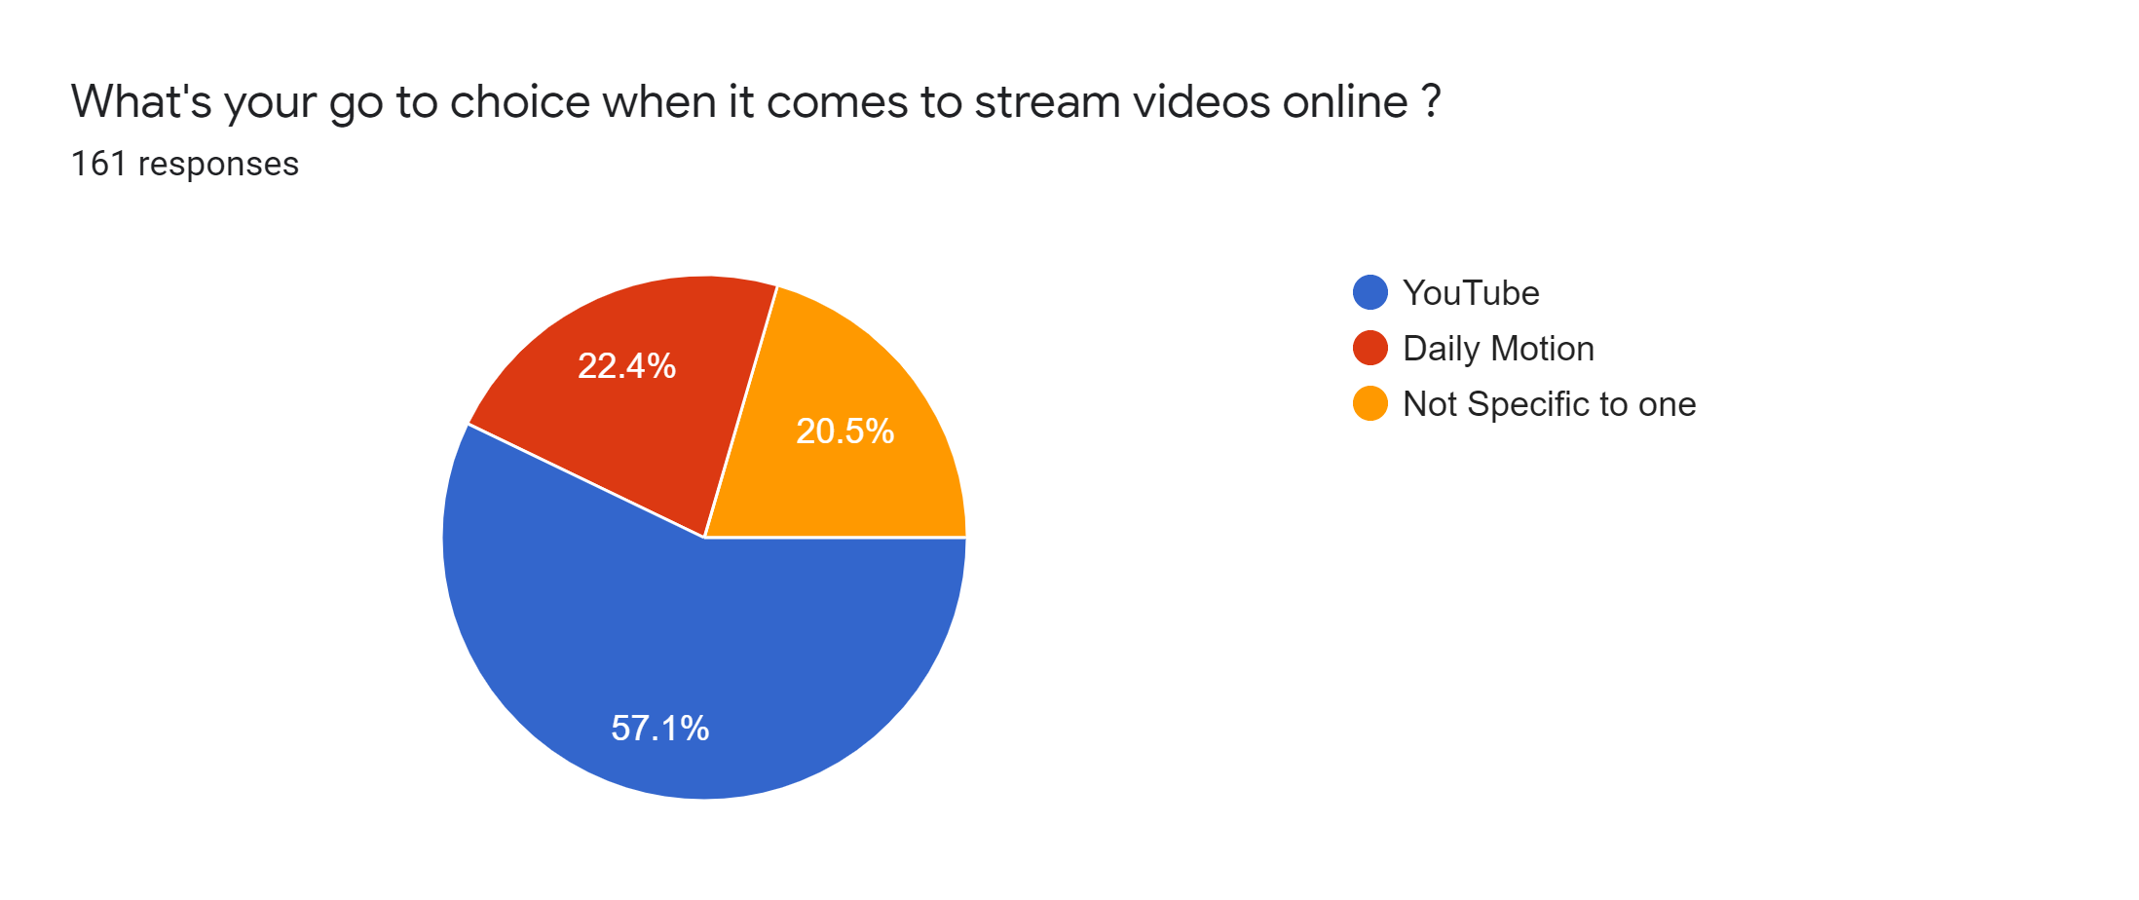
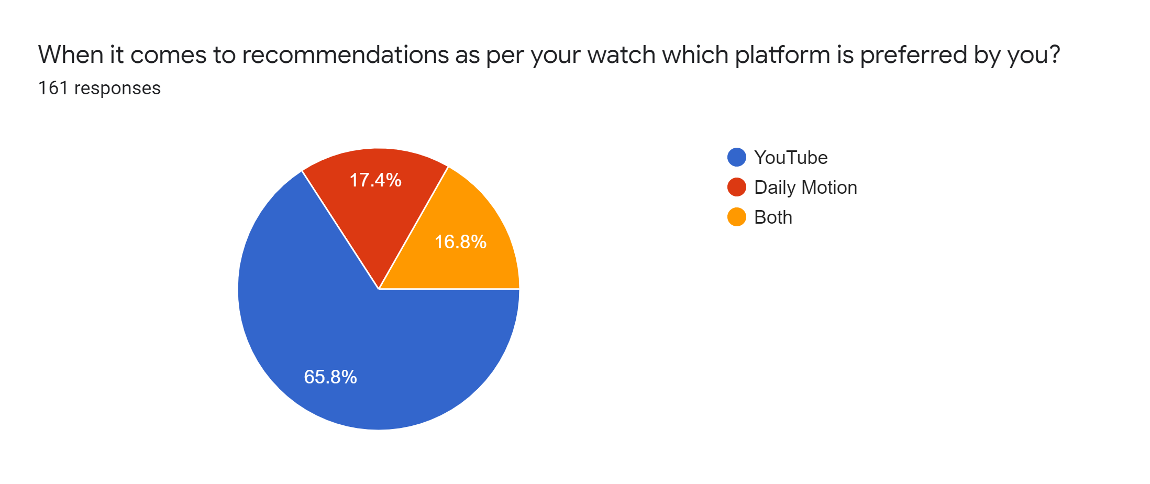
User Opinion Survey
Question : When it comes to recommendations as per watch, which platform is preferred by you ?
Question : What’s your go-to choice when it comes to stream videos online ?

Slide 9
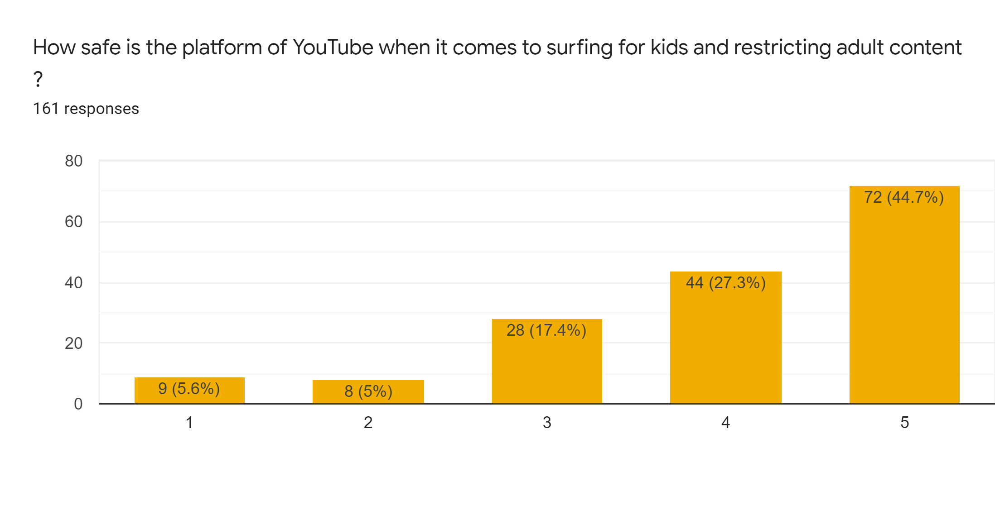
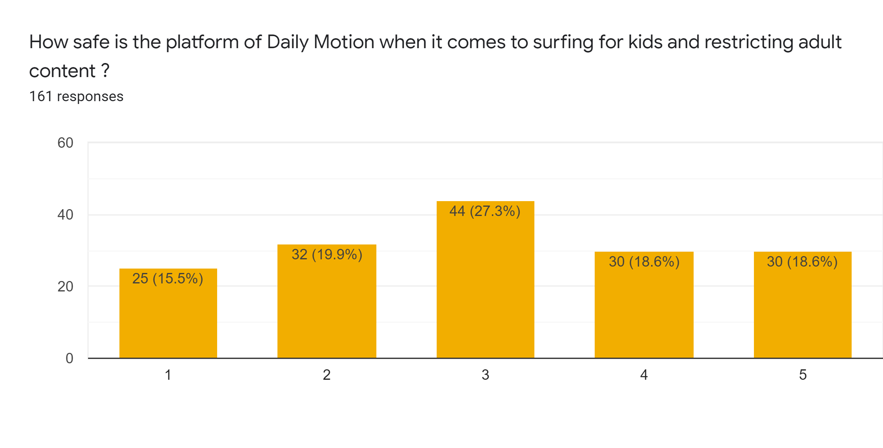
User Opinion Survey

Slide 10
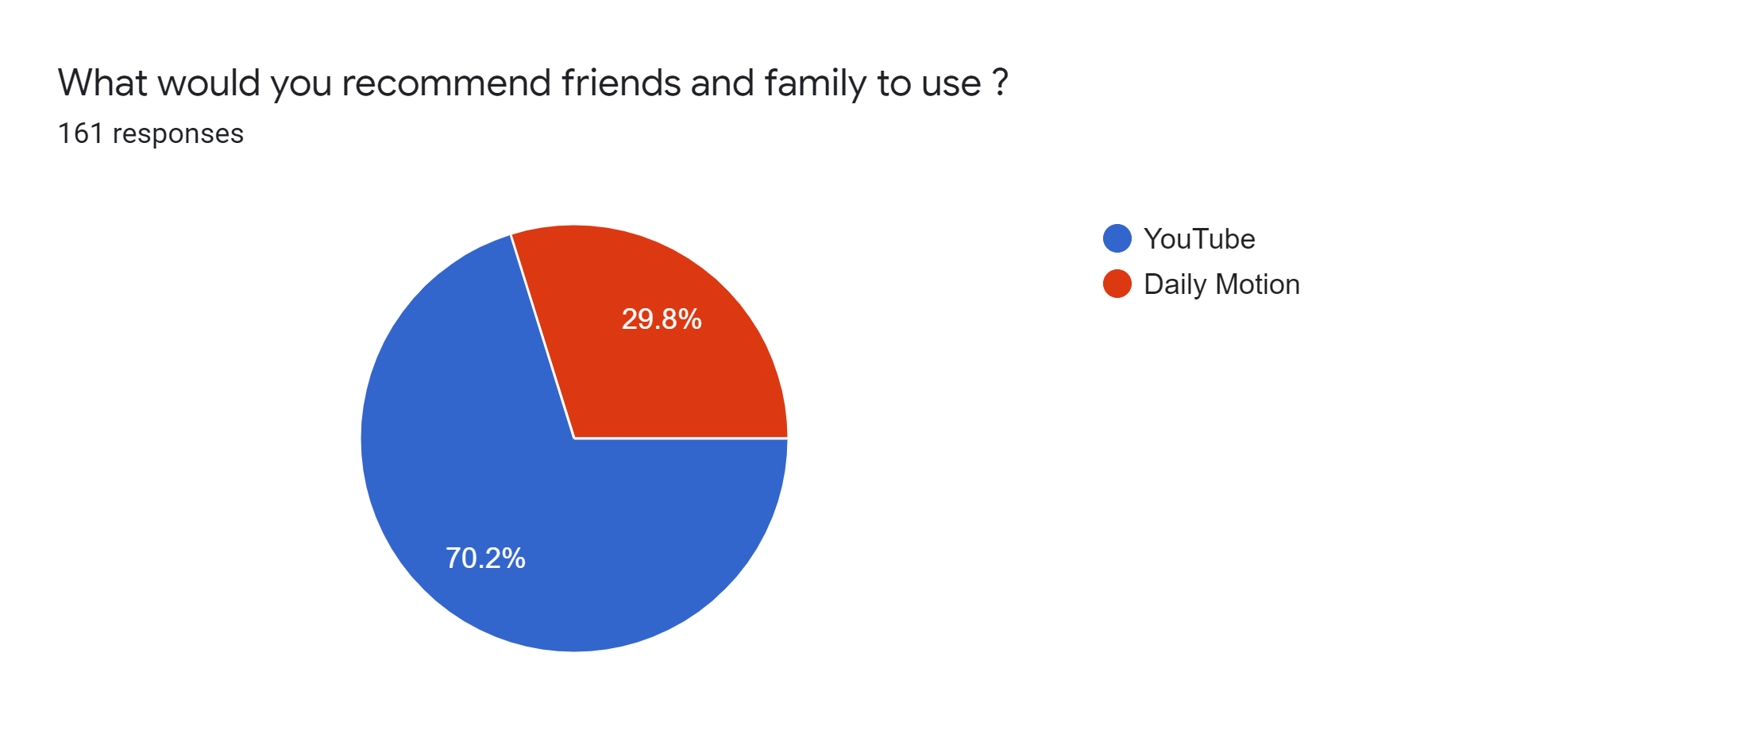
User Opinion Survey
Question : What would you recommend friends and family to use?

Slide 11
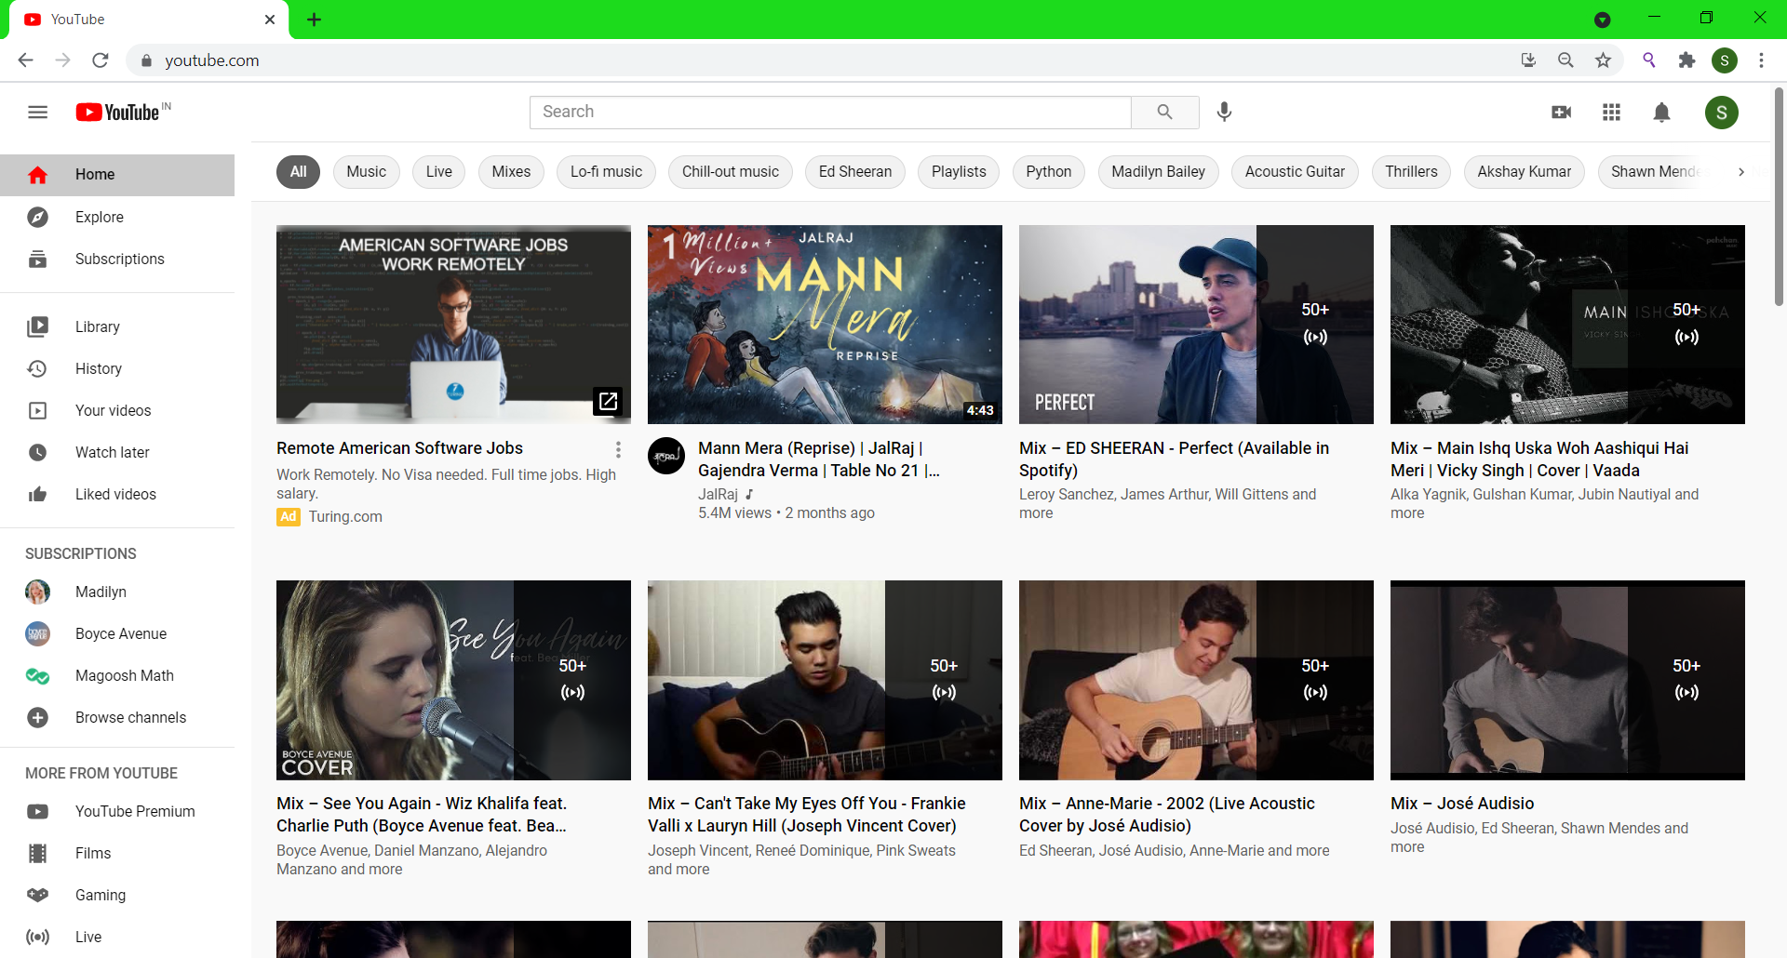
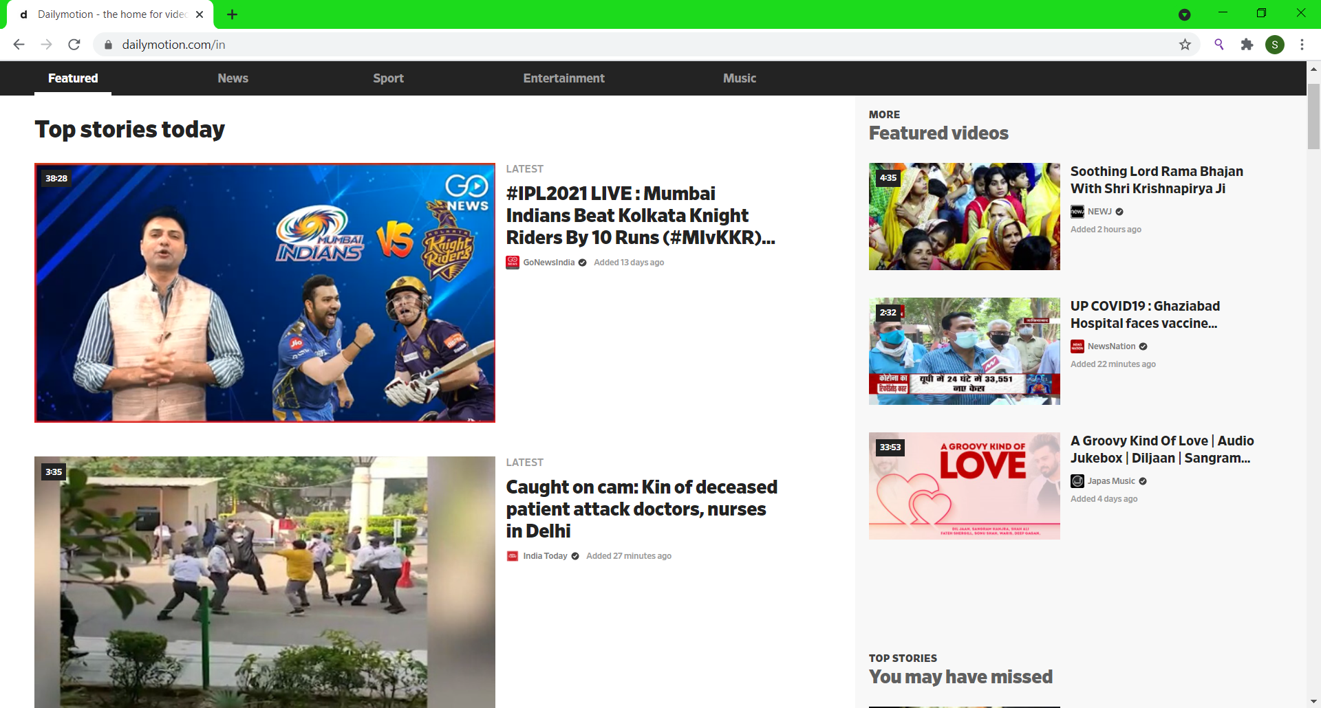
|
YouTube
Dailymotion

Slide 12
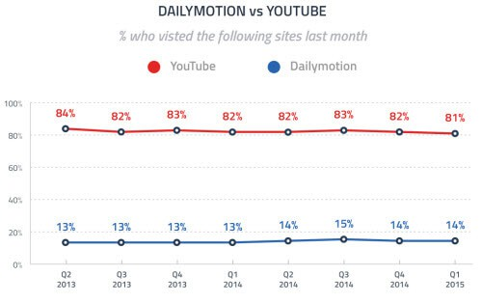
Optimizing User’s Experience
The approx. number of users who visit Youtube and Dailymotion are 7.2 Billion and 122.7 Million respectively.

Slide 13
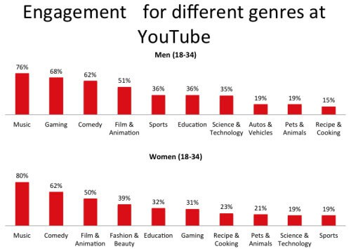
User’s Benefits and Shares
YouTube provides earning and diversity.

Slide 14
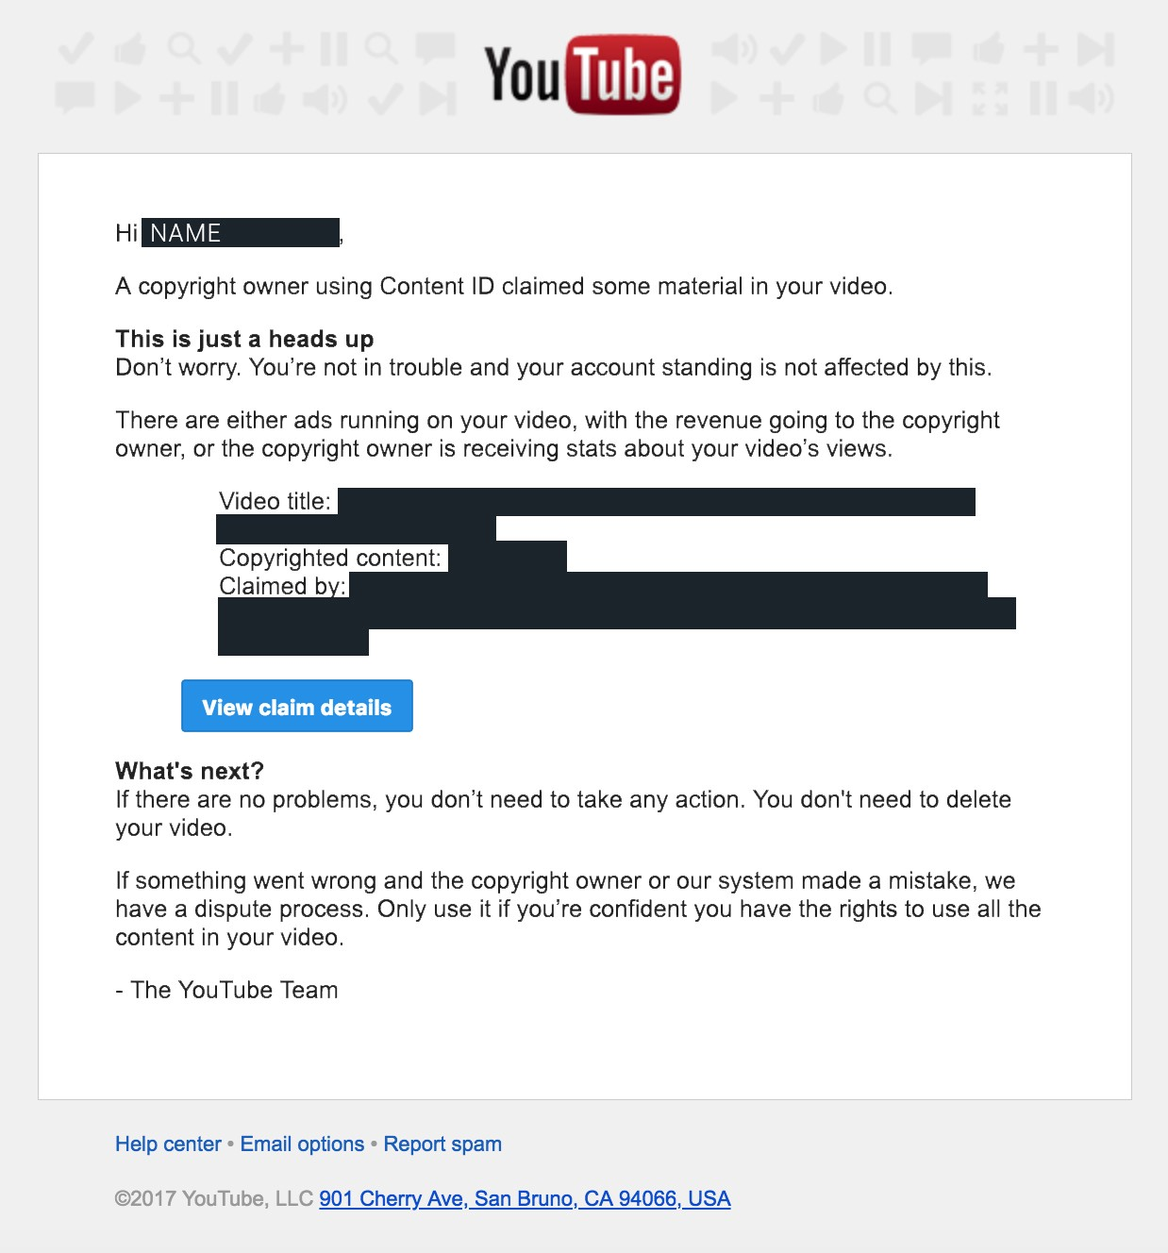
Content Control
YouTube triggers copyright issues for non-original content.

Slide 15
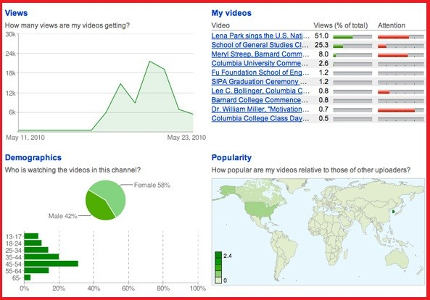
Analysis
YouTube provides statistical tools for analyzing data gathered from uploaded videos.

Slide 16
User Interface Requirements
Content presentation
Simple interface
Feedback mechanism
Default Setting
Purposeful Layout
Responsive

Slide 17


Guidelines and Algorithms
HUMAN COMPUTER INTERACTION
YouTube | DailyMotion
SHIVAM SINGH
20181CSE0669

Slide 18

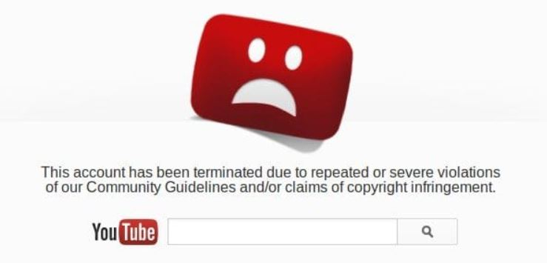
Guidelines
(1) YouTube uses strong DL filters to prevent uploading adult/violent or pornographic content. (2) Strict copyright rules.
(3) YouTube allows download of certain vedios.

Slide 19
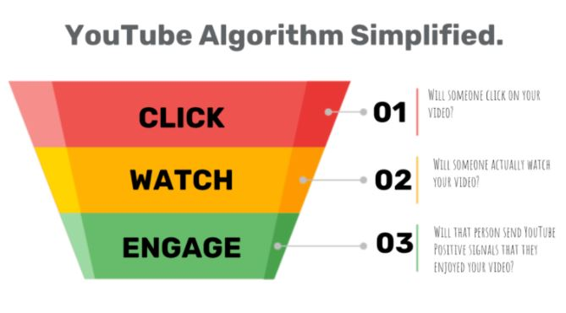

Algorithm
(1) Youtube follows hardware encoding. (2) YouTube is owned by Behemoth Google; that is why it possesses most robust analytics tools as like YouTube insights.
(3) focused on rendering videos upto 8k quality.
(4) Follows Googles styles guide for best code practices.

Slide 20

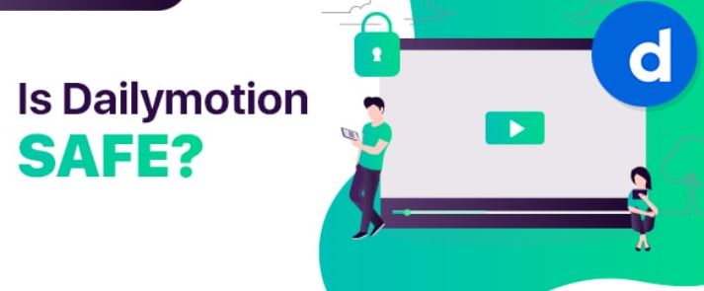
Guidelines
(1) No strict guidelines to restrict adult content on the platform (2) Less effective copyright rules.
(3) Not allow to download vedios.

Slide 21
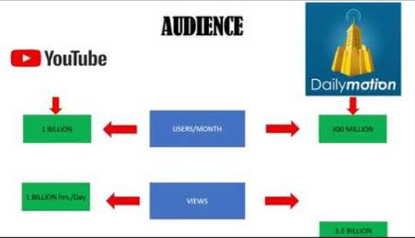
Algorithm
(1) Dailymotion uses H24 codec for video encoding.
(2) Max render upto 2k.
(3) Follows AirBnb style guide.

Slide 22

User interface Software Tools .
Programmatic tools used to create, maintain,or otherwise support other programs.
Ex:Transition diagrams, interface building tools…
S.V.Sai Tarun

Slide 23
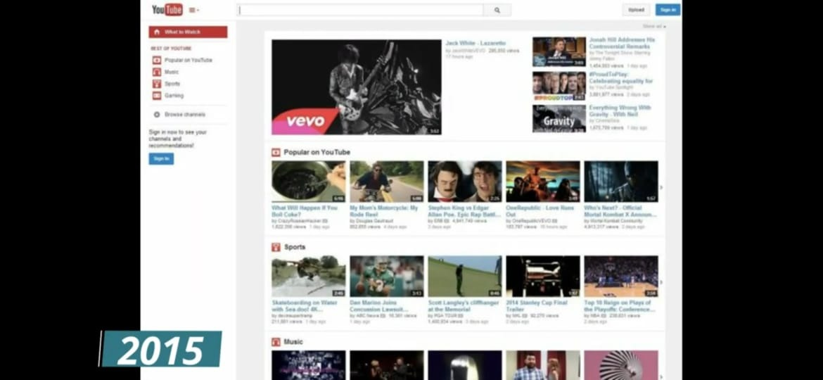
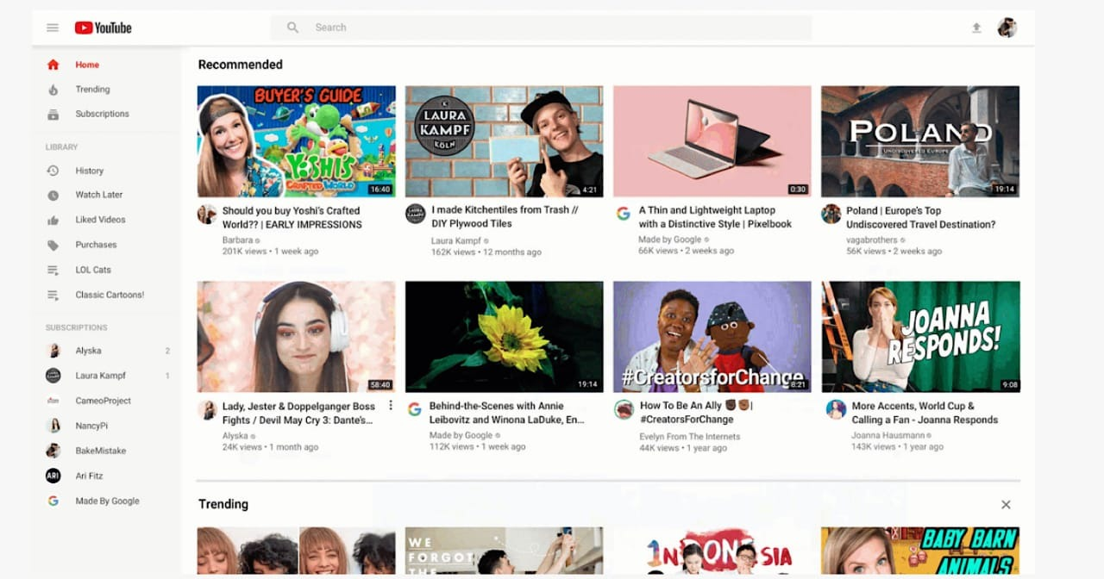
Importance of user interface tools
The quality of the interface will be higher and updating the exiting one becomes easy
The user interface code will be easier and more economical to maintain
S.V.Sai Tarun

Slide 24
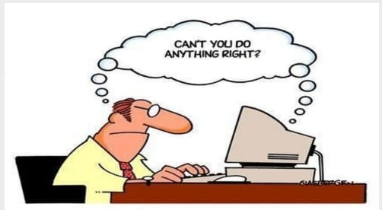
Uses of having tools
• help with screen layout and graphic design,
• validate user inputs,
• handle user errors,
• handle aborting and undoing of operations,
• provide appropriate feedback to show that inputs have been received,
• provide help and prompts,
• update the screen display when application data changes,
• notify the application when the user updates application data,
• deal with field scrolling and editing,
• help with the sequencing of operations,
• insulate the application from all device dependencies and the underlying software and
hardware systems,
• provide customization facilities to end users, and
• evaluate the graphic design and layout, usability, and learnability of the interface.
S.V.Sai Tarun

Slide 25

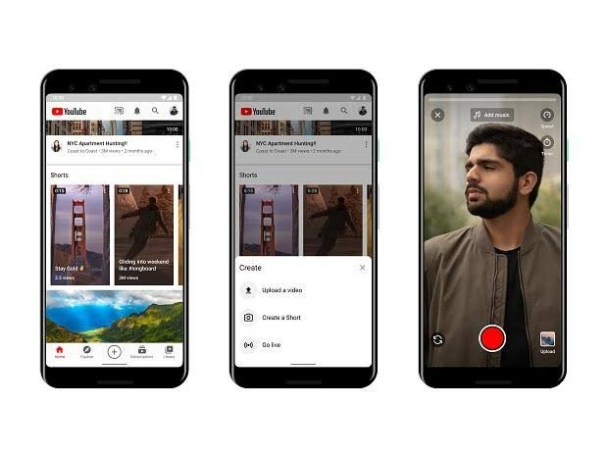
Universal Design Principles
Equitable:
The design is useful and marketable to people with diverse abilities
S.V.Sai Tarun

Slide 26
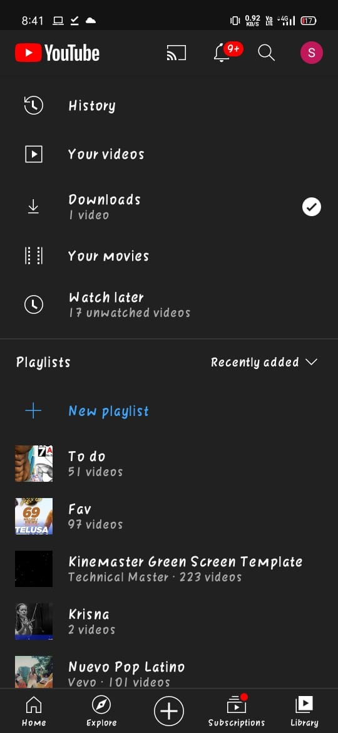
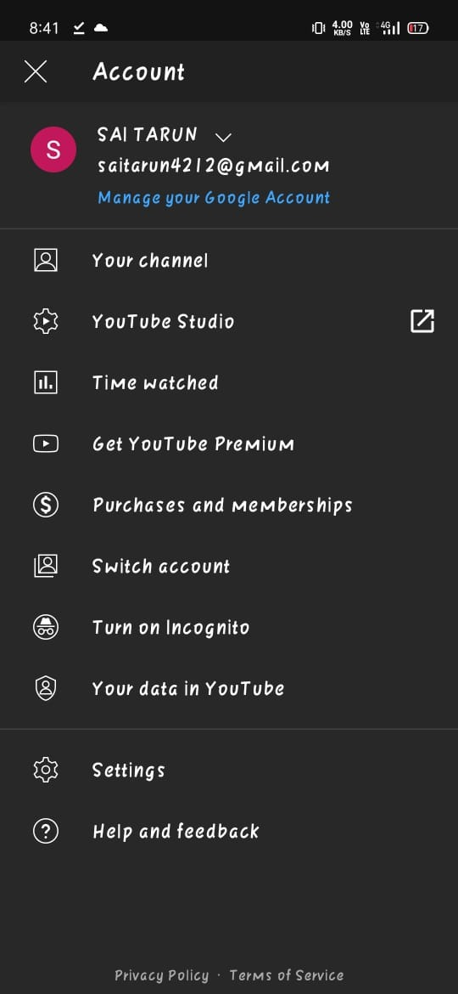
Universal Design Principles
Flexibility in use:
The design accommodates a wide range of individual preferences and abilities.

Slide 27
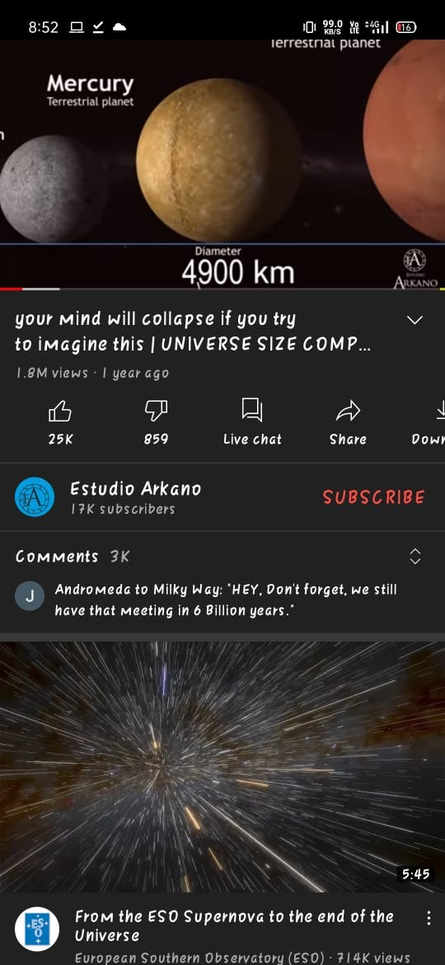
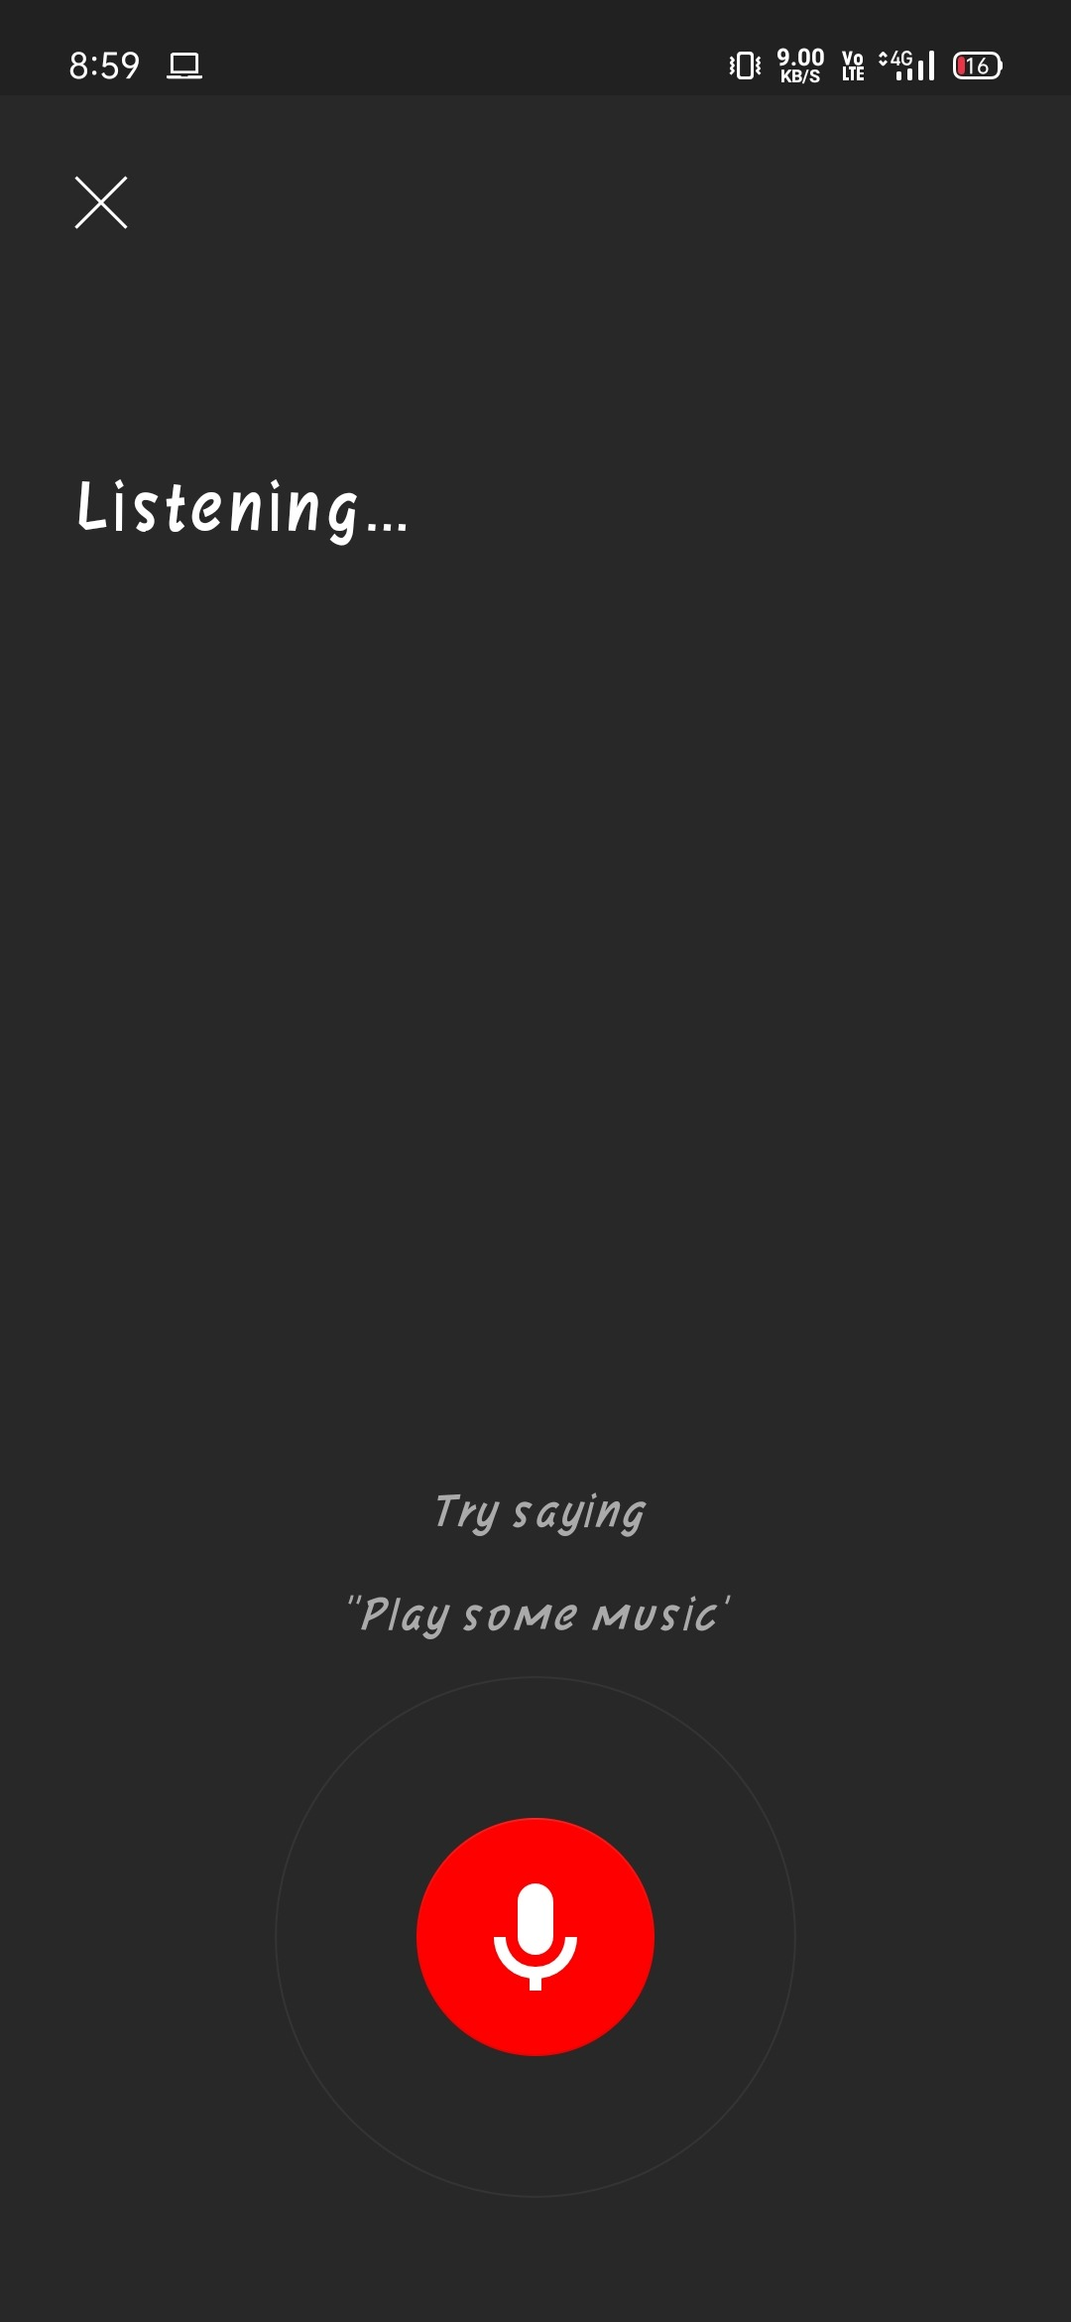
Universal Design Principles
Simple and intuitive:
Use of the design is easy to understand, regardless of the user’s experience, knowledge, language skills, or current concentration level.

Slide 28

Universal Design Principles
Perceptible Information:
The design communicates necessary information effectively to the user, regardless of ambient conditions or the user's sensory abilities.

Slide 29
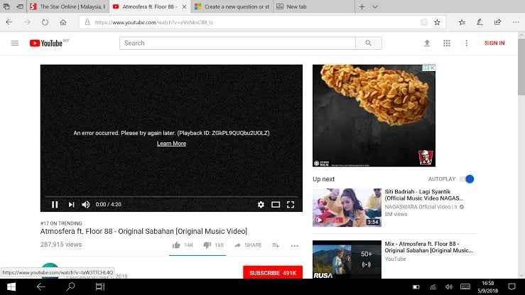
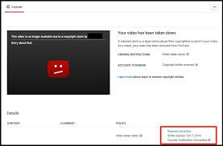
Universal Design Principles
Tolerance for error:
The design minimizes hazards and the adverse consequences of accidental or unintended actions.
copyrights
S.V.Sai Tarun

Slide 30
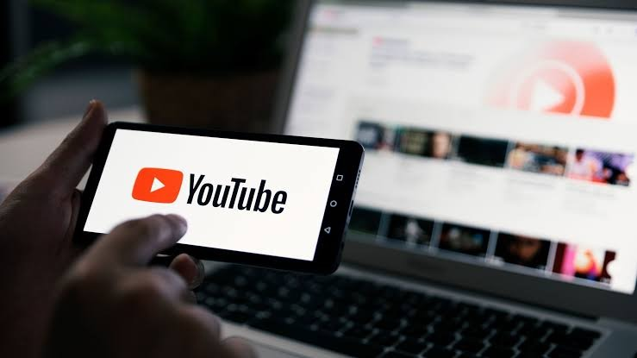
Universal Design Principles
Low physical effort:
The design can be used efficiently, comfortably, and with
a minimum of fatigue

Slide 31
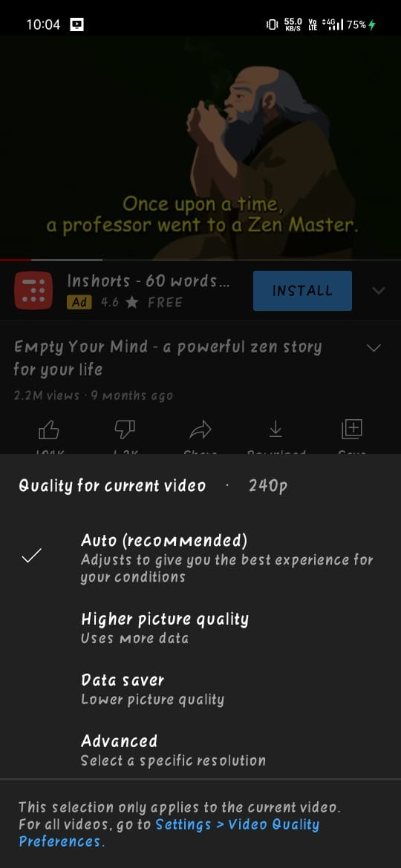
Universal Design Principles
Size and space for approach and use.
Appropriate size and space is provided for approach, reach, manipulation, and use regardless of the user’s body size, posture, or mobility.

Slide 32
HUMAN COMPUTER INTERACTION
YouTube | Daily Motion
EXPERT REVIEW & USABILITY TESTING

Slide 33
YouTube
Testing
Just because Google is a big organization doesn’t mean that everything they do is big -- when it comes to testing, Google favors small, frequent releases and small, concise tests.
This incremental approach allows them to better control changes to the user experience over time and pinpoint issues efficiently. As a result, they invest heavily in the unit and integration testing and use end-to-end testing more sparingly.
In general, they encourage looking for ways to speed up testing cycles and minimize test failures to ensure that the team’s QA process is as efficient as possible.

Slide 34
YouTube
Expert Reviews
YouTube integrates its engineers with the rest of the engineering team to create and scale its developer-owned reviewing approach
At Google, it's the product teams that own quality, not testers. Every developer is expected to do their own testing. The job of the tester is to make sure they have the automation infrastructure and enabling processes that support this self reliance. Testers enable developers to test.

Slide 35
Daily Motion
Testing
2nd Largest Video Streaming site use React to build its UI. They mainly use JEST and React Testing Libraries.
Code is tested only after a component is completely built. Sub components can't be tested.
Code Reviews
Code Reviews are done in pears.
Once the product is completely built, then only code is reviewed in pears

Slide 36


Why YouTube is widely used rather than Dailymotion?
By:
Shlaghana J S
20181CSE0670

Slide 37
There are few disadvantages to using Dailymotion except that it has a smaller reach than YouTube. Also, there are small technical issues with the site like unresponsive pages, broken links (videos that are removed but still show in search results), and constantly having to login.

Slide 38
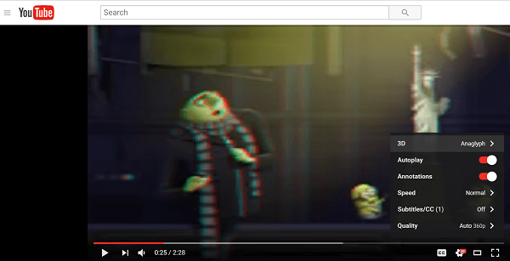
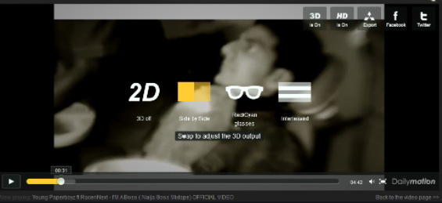
3D capable
Youtube
Dailymotion
YouTube

Slide 39
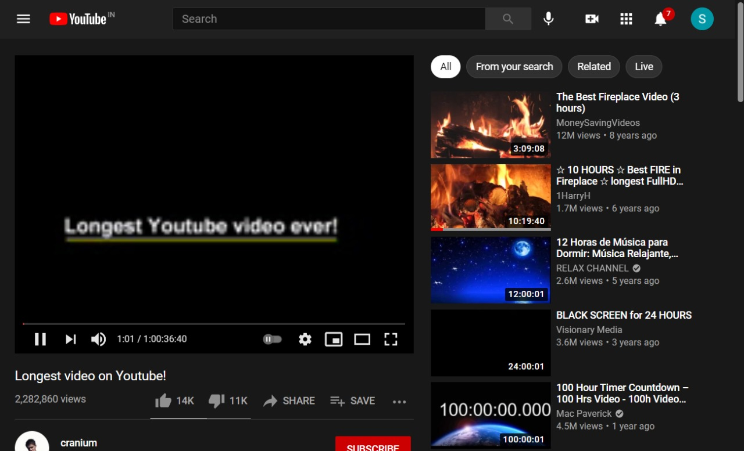
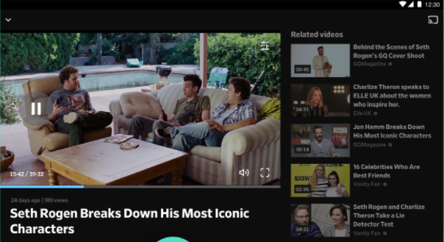
2) Video length
Dailymotion
YouTube

Slide 40
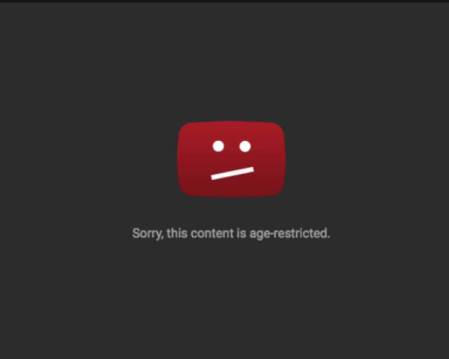

3) Adult Videos
Dailymotion
Youtube

Slide 41
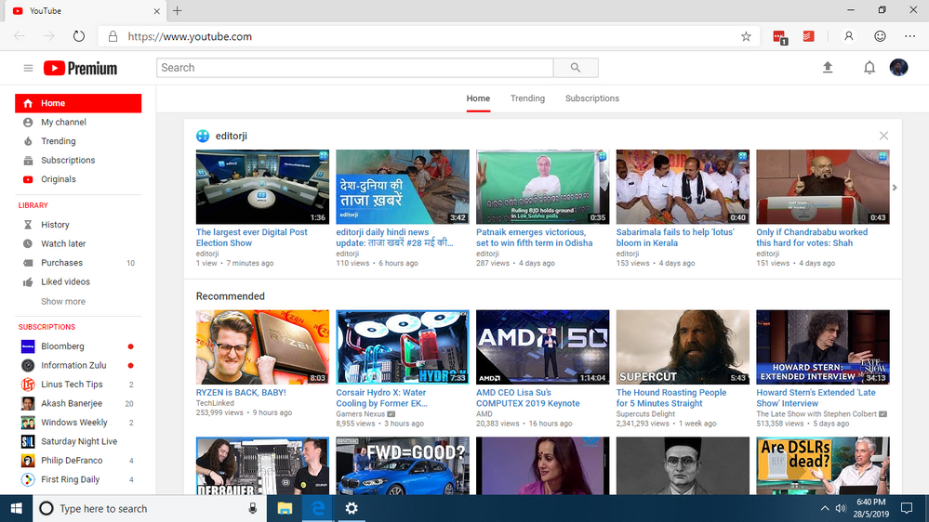
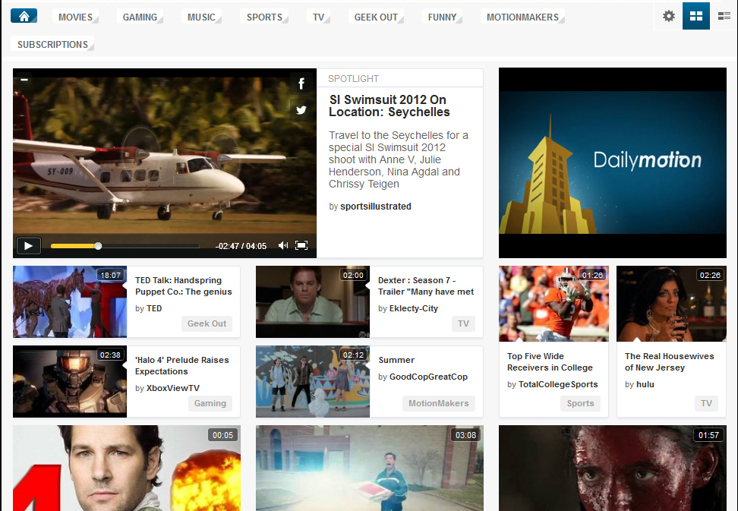
4)Video library
Dailymotion
Youtube

Slide 42
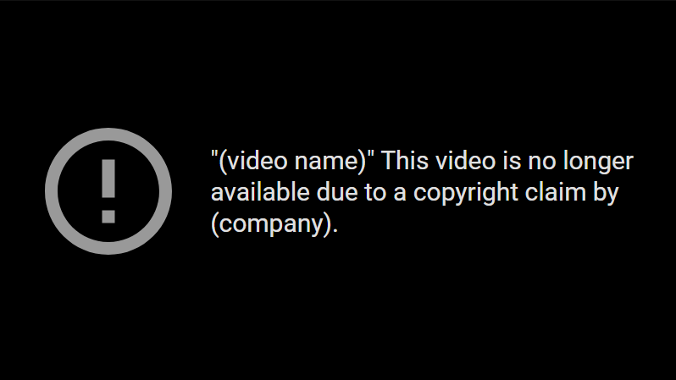
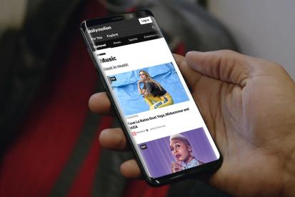
5) Copyright
Dailymotion
Youtube

Slide 43
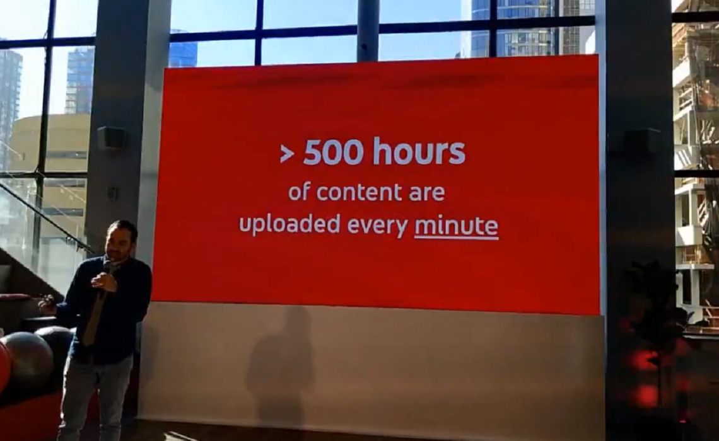
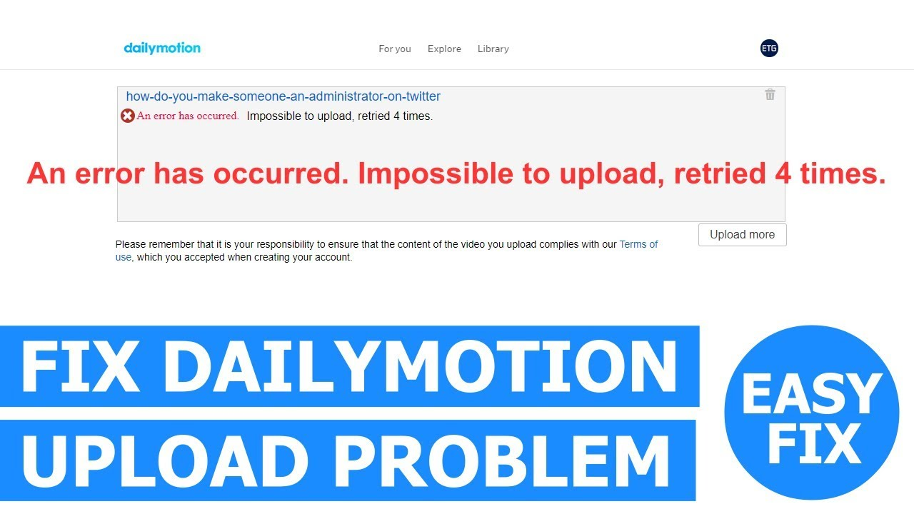
6) Upload limit
Dailymotion
Youtube

Slide 44
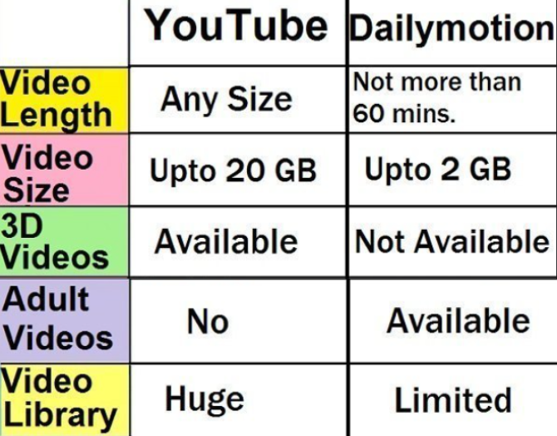
Summary
Interaction design Under 4 pillars of design that is:
User interface requirements
Guidelines documents and processes
User interface software tools
Expert review and usability testing
Why Youtube is widely used rather than Dailymotion

Slide 45
Thank You for your patient listening!!
A presentation by Group – 2
Sai Ram. K – 20181CSE0621
Sai Tarun S.V – 20181CSE0628
Satyam Mourya – 20181CSE0643
Shaiq Iqbal – 20181CSE0660
Shivam Singh – 20181CSE0669
Shlaghana J.S – 20181CSE0670

